Slide 1









FULL STACK PROJECT FSWD 15 – Team 1
TEAM
ORGA
RESULT
CHALLENGES
PROJECT

Slide 2
PROJECT
THEME Mealplanner
REQUIRE Log in
User: CRUD Recipes (own)
Admin: Recipes & Users
ALL: CRUD Mealplanner
NICE TO HAVE Rating, Shopping Cart, Nutrition & Allergen Info
TECH Symfony
SCSS / Illustrator
GitHub

Slide 3
TEAM
PETRA SEDLACZEK Design / Frontend
SANJA KOSTANTINOVIC Database / Backend
GABRIEL SKRABA Design / Frontend
STEPHAN REINDL PJ-Lead / Backend

Slide 4
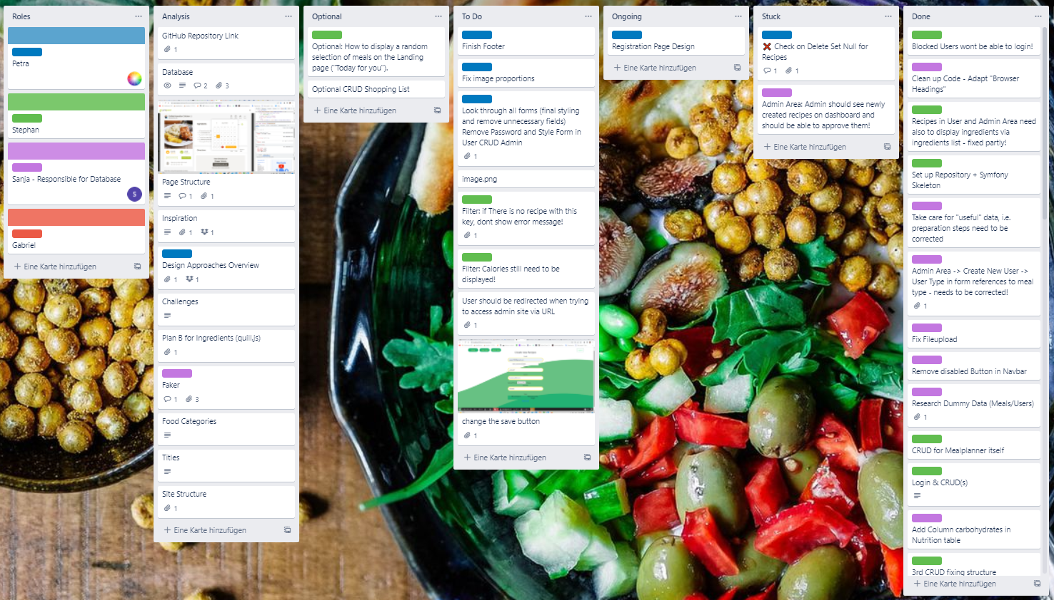
ORGA
SPRINT DURATION: 1 DAY
MEETINGS 2/DAY 15min
TRELLO BOARD

Slide 5
CHALLANGES
SYMFONY Webpack Query Builder
Multiple tables
Nesting forms/CRUDs
STRENGHTS
TEAMWORK Clear separation of tasks
very structured work attitude

Slide 6
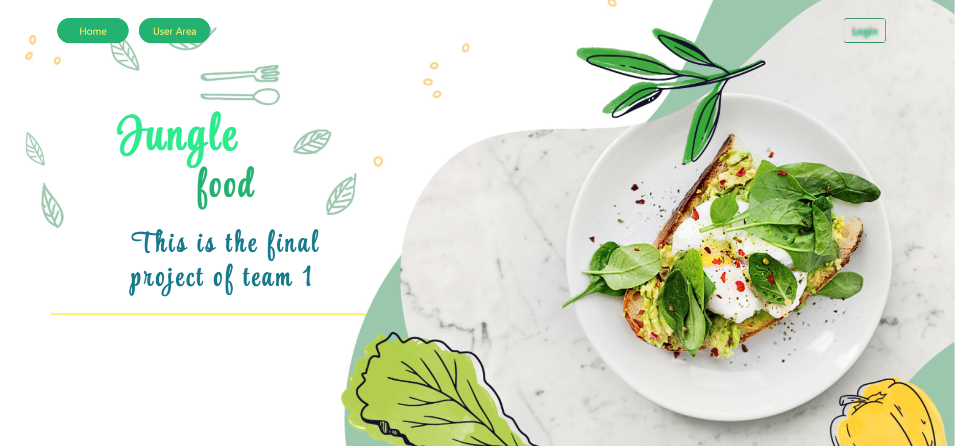
RESULT
JUNGLE FOOD MEALPLANNER

